Slide 1

In Store Shopping Made Easy
Changing in-store retail game
Presenting ‘Shoppen’
Logo & Tagline

Slide 2
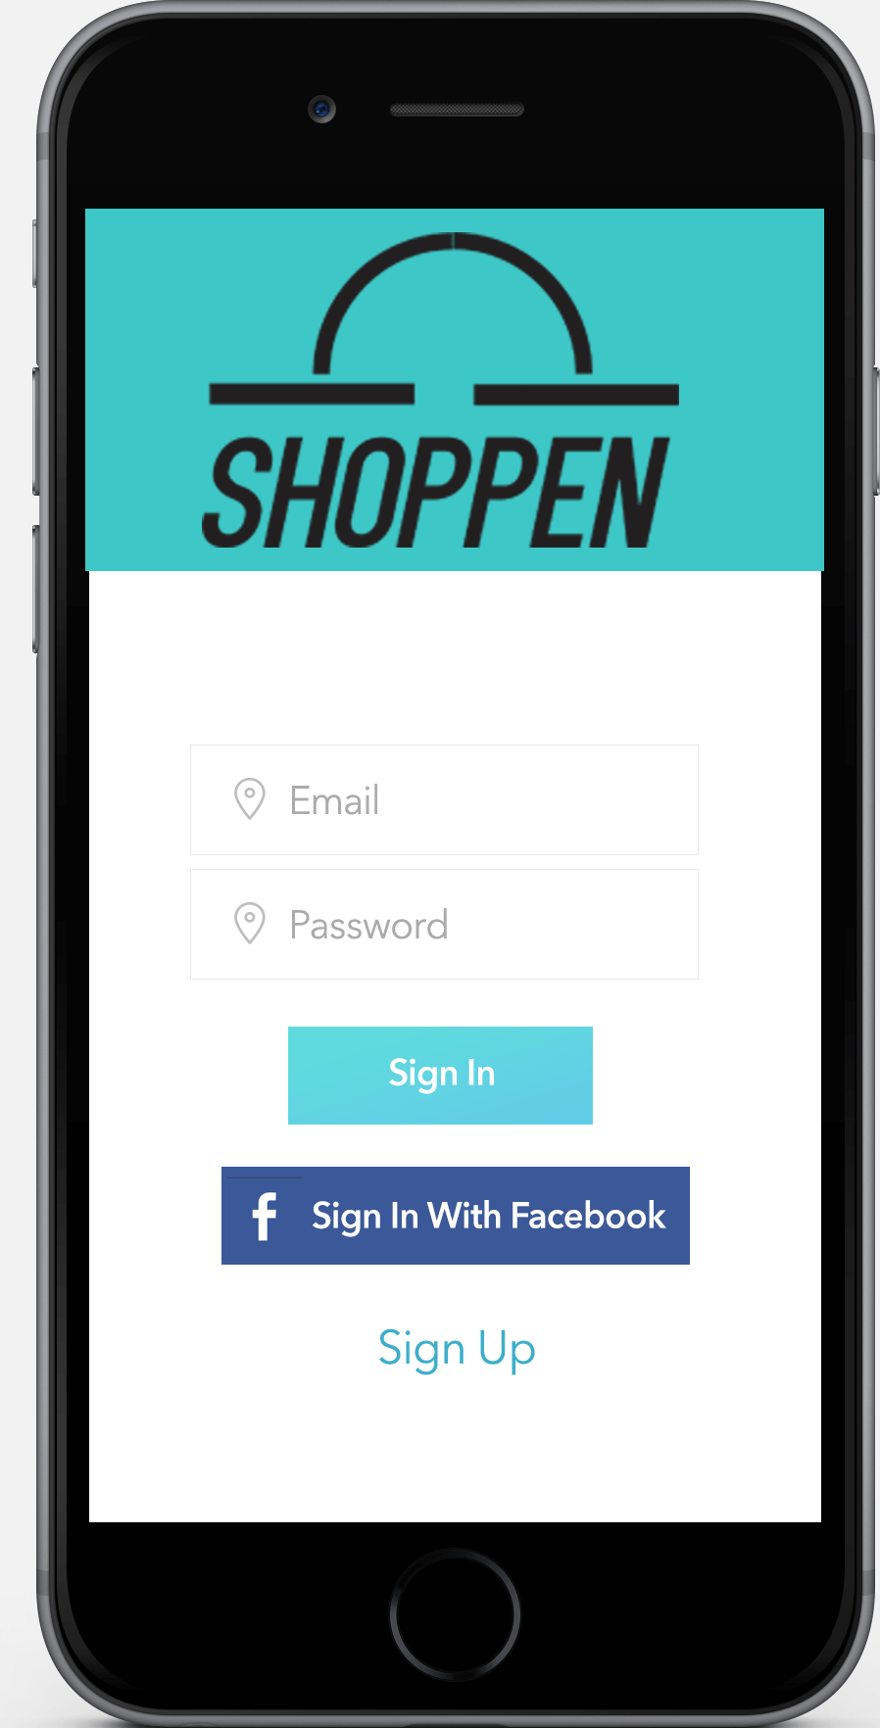

Slide 3
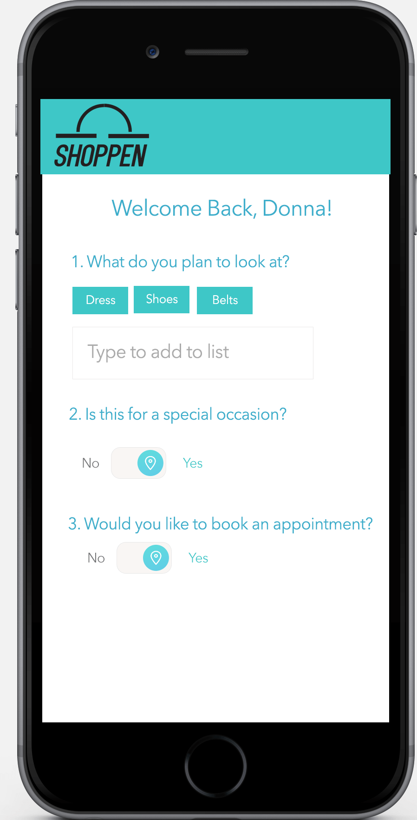

Slide 4
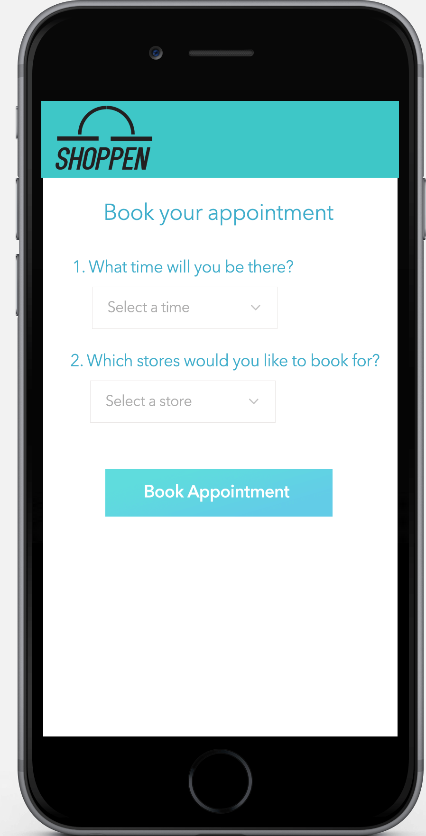

Slide 5
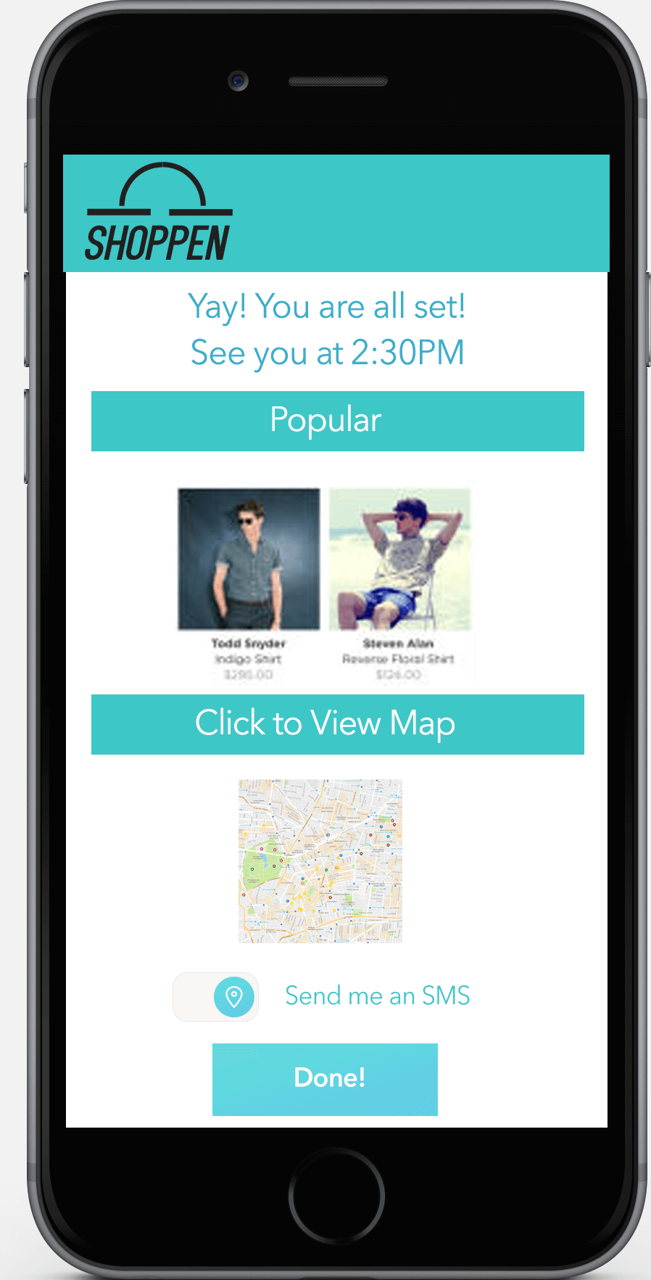

Slide 6
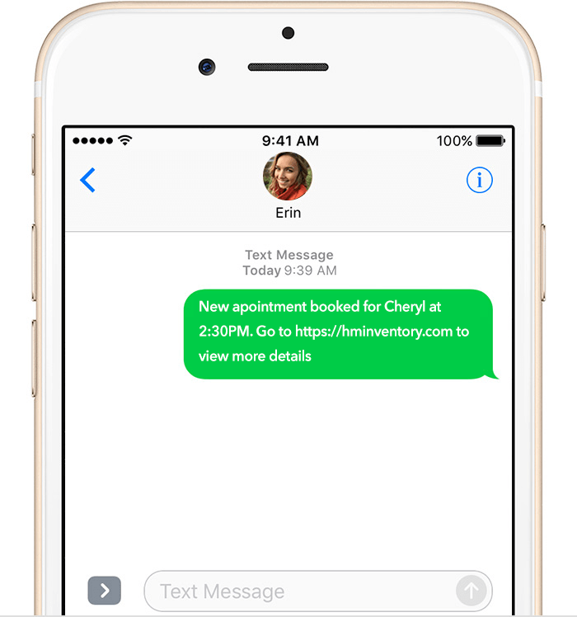

User Journey Retailer
Sees Check in when connected to WiFi: Name & what person is looking for
Can directly address her needs
scan products that were tried on

Slide 7
A Product Retailers Will Love
Bridging the gap between online & offline sales
Seamless customer experience
Streamlining the onsite customer journey

Slide 8
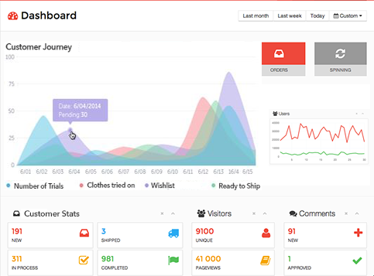
Specific Customer Journey Data

Slide 9
In Store Shopping Made Easy

